Slide 1

語言學、語音學、語音信號處理
Min-Siong Liang

Slide 2

摘要
自我介紹
  姓名、專題、暑假計畫
語音簡介
拼音系統
語音訊號處理
  特徵擷取
Msp論壇、paper選讀、書籍網站推薦

Slide 3
語音簡介
語音領域
  語音學(acoustics)
  語言學(linguistics)
語音學(acoustics)
  聲韻學(prosody)(八塊學長)
  聲學統計(acoustics model)
語言學(linguistics)
  型態學(morphology)
  語義學(semantics)
應用

Slide 4
語言學1(linguistics)
型態學(morphology)
  Ex. Fox 復數 foxes
  Morphological parsing: foxes → fox and –es
  發生在拼音語言上
語義學(semantics)
  語義分析(semantic analysis)
Output
Semantic
Representations
Parser
Semantic
Analyzer

Slide 5
語言學2(linguistics)
  文法(Grammar)加入
    字與字的相關、詞與詞的相關
    觀、觀世音、觀世音菩薩
應用：
  NLP (nature language processing)
  Information retrieval
  Spoken Dialogue system

Slide 6
拼音系統1
IPA (international phonetic alphabet)
  可拼出世界上所有語言
  但符號(symbol) 非ascii code
通用拼音v.s.漢語拼音
  漢語拼音：最廣為使用的華語拼音系統(1958)
    缺點：
      無法拼出非華語語言
      “ㄩ”的拼法無法統一
      “ㄟ”用法不一致，容易與“ㄝ”混淆
      “ㄡ”的用法也不佳
注音符號 | 通用拼音 | 漢語拼音
ㄒㄩㄥ | syong | xiong
ㄌㄩ | lyu | lu:(lU)
ㄒㄩ | syu | xu
ㄍㄨㄟ | guei | gui
ㄍㄟ | gei | ge
ㄌㄧㄝ | lie | lie

Slide 7
拼音系統2
通用拼音
  改善以上缺點
  適用於台灣三大族群
Reference: http://www.geocities.com/hao520/research/papers/pinyin-xref.htm

Slide 8
實驗室發展的拼音系統
TWBet1
  One phoneme one symbol
TWBet2
  類似通用拼音
漢字 | TWBet1 | TWBet2
餡 | A | ann

Slide 9
音素、聲母、韻母、聲調
音素(Phoneme)
  The minimum units of speech sound in a language which can serve to distinguish one word from the other
  Phone: a phoneme’s acoustic realization
聲母(initial)
韻母(final)
聲調(tone)
條 | d | i | a | u | 2
 |  | 介音 | 元音
漢字 | 聲母 | 韻母 |  |  | 聲調

Slide 10
音節、詞、句子
音節(Syllable)
  文字上的最小單位,例如：每個漢字都成一個音節
  英文沒有syllable的層面
詞(word)
  文字上有意義的最小單位
  例如：學生(student)
句子(sentence)
  一堆詞的連結，完成一個有意義的一句話

Slide 11
拼音練習1(ㄅㄆㄇ v.s. TWBet2)
ㄅㄆㄇ | abc
ㄅ | b
ㄆ | p
ㄇ | m
ㄈ | (f)
ㄅㄆㄇ | abc
ㄉ | d
ㄊ | t
ㄋ | n
ㄌ | l
ㄅㄆㄇ | abc
ㄍ | g
ㄎ | k
ㄏ | h
ㄅㄆㄇ | abc
ㄞ | ai
ㄟ | ei
ㄠ | au/ao
ㄡ | ou
ㄢ | an
ㄣ | 略
ㄤ | ang
ㄥ | 略
ㄅㄆㄇ | abc
ㄧ | i
ㄨ | u
ㄩ | (yu)
ㄚ | a
ㄛ | o
ㄜ | or/er
ㄝ | e
ㄦ | 略
ㄅㄆㄇ | abc
ㄐ | z
ㄑ | c
ㄒ | s
ㄅㄆㄇ | abc
ㄗ | z
ㄘ | c
ㄙ | s
ㄅㄆㄇ | abc
ㄓ | 略
ㄔ
ㄕ
ㄖ
Exercise:小小練習

Slide 12
聲母表
 | 漢字例 | 羅馬字記號 |  | 漢字例 | 羅馬字記號
1 | 保 | b | 13 | 資 | z
2 | 坡 | p | 14 | 此 | c
3 | 冒 | m | 15 | 思 | s
4 | 帽 | v | 16 | 如 | r
5 | 刀 | d | 17 | 好 | h
6 | 討 | t | 18 | 英 | 零聲母
7 | 怒 | n
8 | 路 | l
9 | 糕 | g
10 | 科 | k
11 | 雅 | nq
12 | 鵝 | q

Slide 13
韻母表
 | 漢字例 | 舒喉韻 | 漢字例 | 束喉韻
1 | 阿 | a | 鴨 | ah
2 | 會 | e | 窄 | eh
3 | 伊 | i | 裂 | ih
4 | 烏 | o | ○ | oh
5 | 蚵 | or | 學 | orh
6 | 有 | u | ○ | uh
7 | 愛 | ai | ○ | aih
簡略列出
介紹拼音練習程式

Slide 14
作業一
Source
  音節對照表
  Lab檔
將lab檔裡面的音節轉換成我要的拼音系統
Old | TWBet1 | TWBet2
xiong | sioG | siong
0 100000 sil
100000 1000000 sioG
1000000 1100000 sil
0 100000 sil
100000 1000000 xiong
1000000 1100000 sil
0 100000 sil
100000 1000000 siong
1000000 1100000 sil

Slide 15
Take a break

Slide 16

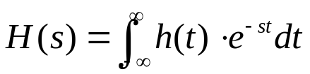
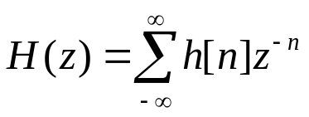
語音訊號處理(1)
信號與系統
  LTI system
  h(t)、h[n]: impulse response
  Laplace-transform :用在連續時間
    h(t) → H(s)
  Z-transform:
    h[z] → H(z)
x(t)
x[n]
h(t)
h[n]
y(t)
y[n]

Slide 17
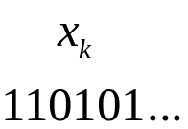


語音訊號處理(2)
x(t)
LPF
x[n]
Processing
Algorithm
output
Major application areas
  Speech Coding :Digitization and Compression
    Considerations:
      Bit rate
      Recover quality
      Computation complexity/feasibility
  Voice Interface for Human-Network Interaction
Processing
Inverse
Processing

Slide 18
語音訊號處理(3)
Carrying Linguistic Knowledge and Human Information: Characters, Words, Phrases, Sentences, Concepts, etc.
Double Levels of Information: Acoustic Signal Level/Symbolic or Linguistic Level
Processing and Interaction of the Double-level Information

Slide 19
特徵擷取(feature extraction)
語音信號產生(Speech Production)
語音信號感知(Speech Perception)
Speech Signal Analysis : Feature Extraction
  Mel-Frequency Cepstral Coefficients (MFCC)

Slide 20
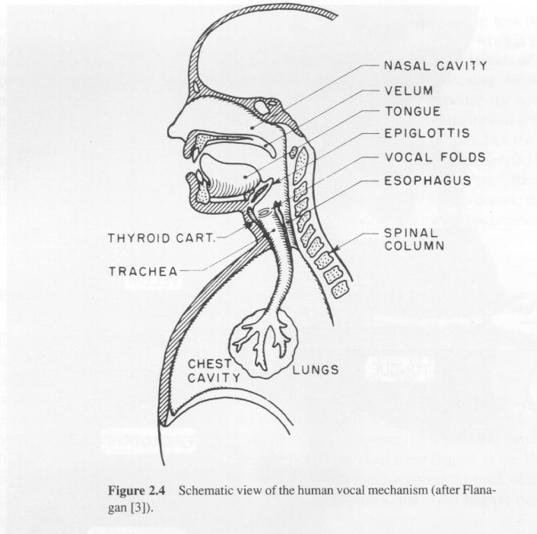
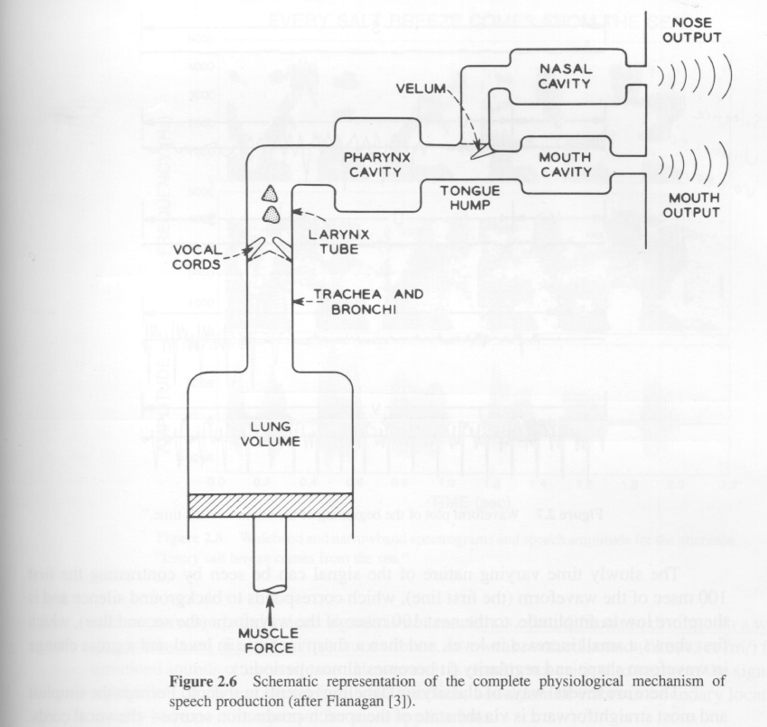
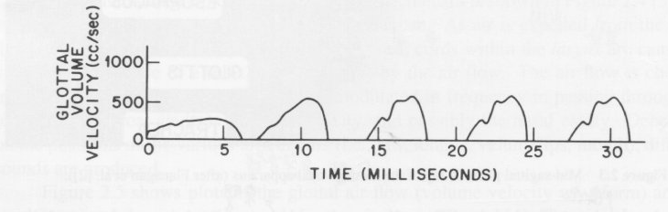
Speech Production
Schematic representation of the complete
physiological mechanism of speech production
Schematic view of the human vocal mechanism
Glottal volume velocity
(excitation)

Slide 21




Speech Production
Sophisticated model for sound production
Simplified model for sound production
Voiced
Pitch period, P
Gain
DT
Impulse
Generator
G(z)
Glottal
filter
Voiced/unvoiced
switch
u(n)
Voice
volume
velocity
H(z)
Vocal Tract
Filter
R(z)
Lip
Radiation
Filter
s(n)
Speech
Signal
V
Uncorrelated
Noise
Generator
U
Gain
Unvoiced
Pitch period, P
Voiced
DT
Impulse
Generator
Voiced/unvoiced
switch
All-pole
Filter
s(n)
Speech
Signal
V
White
Noise
Generator
U
Gain
Unvoiced

Slide 22
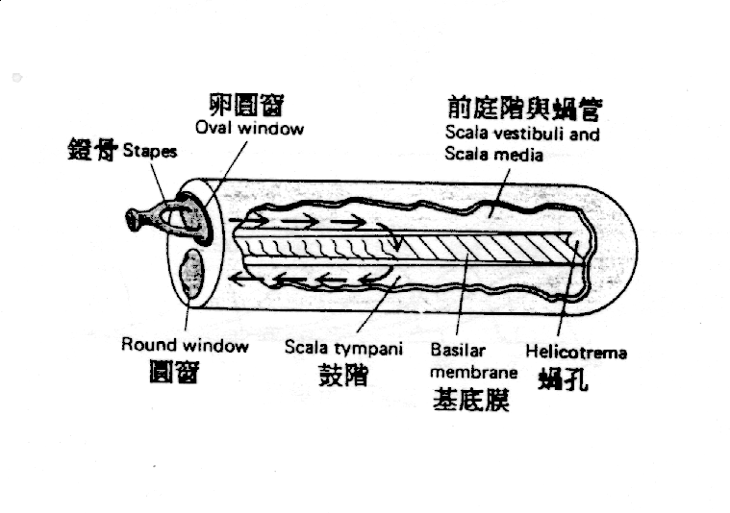
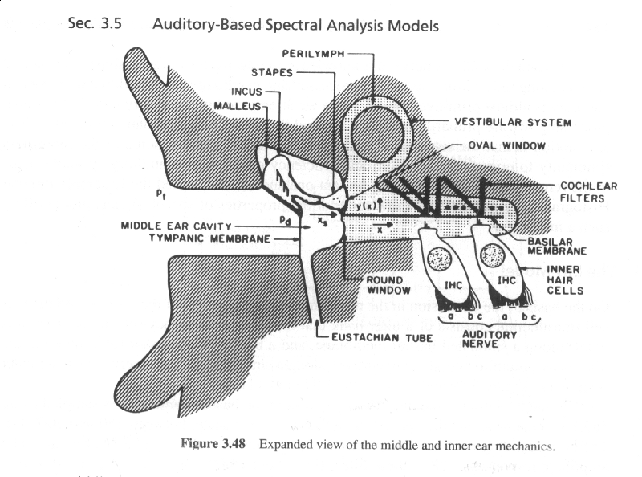
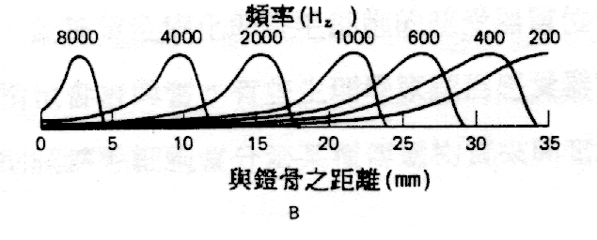
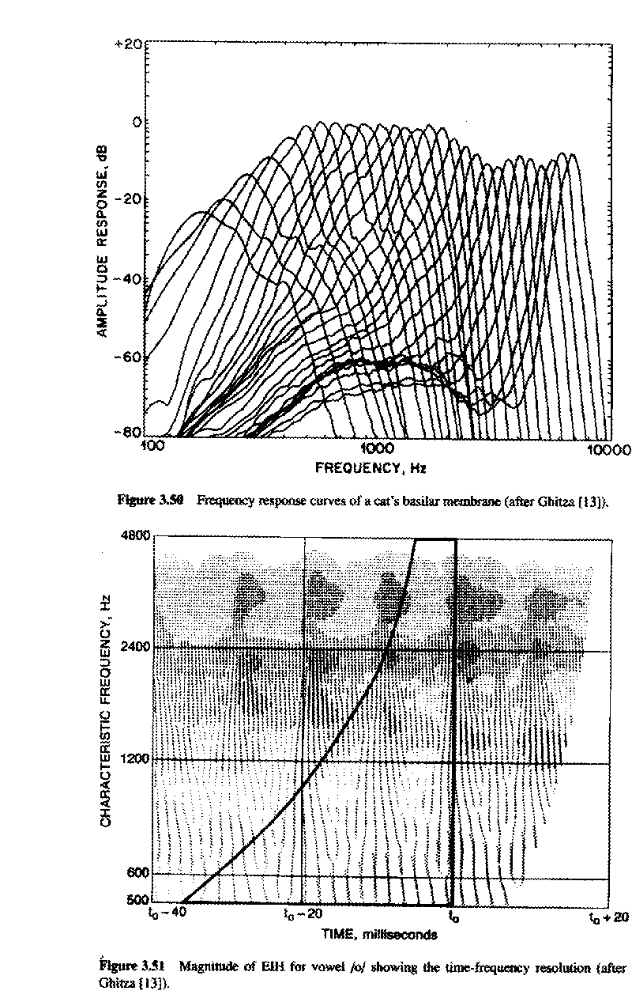
Speech Perception
Middle and inner ear mechanics

Slide 23
Speech Signal Modeling : Feature Extraction
Three Main Driving Forces
Perceptually Meaningful Parameters
  Parameterizations are sought that represent salient aspects of the speech signal....
  Preferably parameters that analogous to those used by human auditory system.....perceptually meaningful
Robust Parameters
  Parameterization are desired that are robust to variations in channel, speaker, and transducer
Time-Dynamic Parameters
  Parameters can capture spectral dynamics, or changes of the spectrum with time ....temporal correlation problem

Slide 24
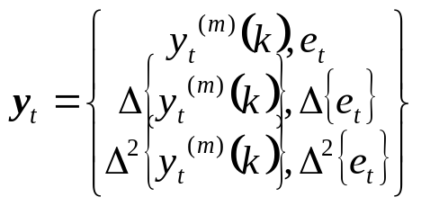
Feature Extraction : MFCC
Mel-Frequency Cepstral Coefficients (MFCC)
  Most widely used in the speech recognition
  Has generally obtained a better accuracy and a minor computational complexity
  The scheme of MFCC processing :
Speech signal
x_{t}(n)
X_{t}(k)
Mel
filter banks
Pre-emphasis
DFT
x(n)
x’(n)
Window
Y_{t}(m)
energy
Log(| |²)
e_{t}
derivatives
y_{t} ^{(m)}(k)
Y_{t}’(m)
IDFT
MFCC

Slide 25
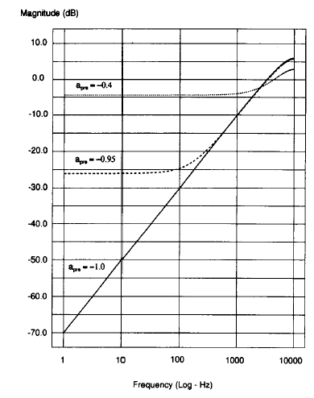
Feature Extraction : Pre-emphasis
The process of Pre-emphasis :
  a high-pass filter
Speech signal x(n)
x’(n)=x(n)-ax(n-1)
H(z)=1-a • z⁻¹ 0<a≤1

Slide 26
Why pre-emphasis? (1)
Reason 1: Physiological Characteristics
  The minimum-phase component of the glottal signal can be modeled by a simple two-real-pole filter whose poles are near z=1
  The lip radiation characteristic, with its zero near z=1, tends to cancel the spectral effects of one of the glottal pole
  ==> By introducing a second zero near z=1 (pre-emphasis), can eliminate effectively the larynx and lips spectral contributions.
  =>Analysis can be asserted to be seeking the parameters corresponding to the vocal tract only
Reason 2: Prevent Numerical Instability
  If the speech signal is dominated by low frequencies, it is highly predictable and a large LP model will result in an ill-conditioned autocorrelation matrix

Slide 27
Why pre-emphasis? (2)
Reason 3 :
  Voiced sections of the speech signal naturally have a negative spectral slope (attenuation) of approximately 20 dB per decade due to physiological characteristics of the speech production system
  High frequency formants have small amplitude with respect to low frequency formants. A pre-emphasis of high frequencies is therefore require to obtain similar amplitude for all formants
Reason 4 :
  Hearing is more sensitive above the 1 kHz region of the spectrum

Slide 28
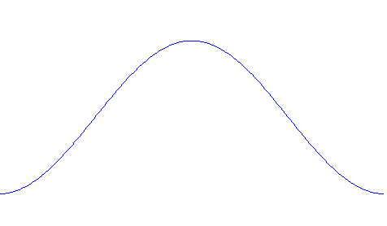
Feature Extraction : Windowing
The process of windowing : frames
Frame-based
overlapping
Hamming window

Slide 29
Why Windowing? (1)
Why separating the signal into successive and overlapping frames?
  Traditional methods for spectral evaluation are reliable in the case of a stationary signal (i.e., a signal whose statistical characteristics are invariant with respect to time)
    For voice, this holds only within the short time intervals of articulatory stability
Frames
  Frame Duration (T_{f}) : the length of time over which a set of parameters is valid. Frame duration ranges between 20 ~ 10 ms
  Frame Period: the length of time between successive parameter calculations
  Frame Rate: the number of frames computed per second

Slide 30
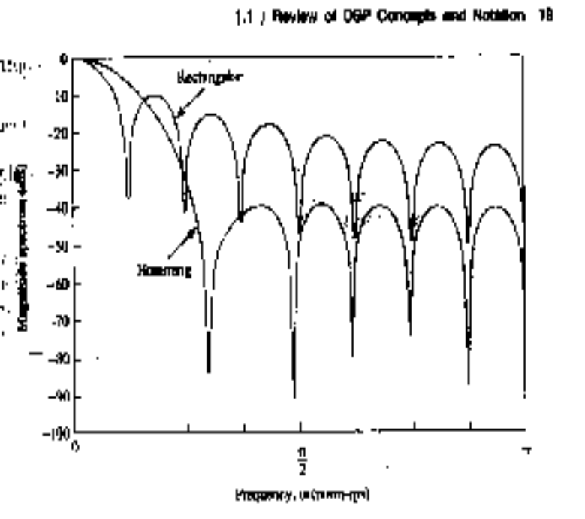
Why Windowing? (2)
Windowing :
  x_{t}(n)=w(n)•x’(n), w(n): the impulse response of the window
    Frequency response : X_{t}(f)=W(f)*X’(f), *: convolution
  Ideally, w(n)=1 for all n , whose frequency response is just an impulse
    This is invalid since the speech signal is stationary only
    within the short time intervals
  Rectangular window (w(n)=1 for 0≤n<1):
    just extract the frame part of signal without further processing
    Whose frequency response has high side lobes
  Main lobe : spreads out in a wider frequency
  range the narrow band power of the signal,
  and thus reduces the local frequency
  resolution
  Side lobe : swap energy from different
  and distant frequencies of x’(n),
  which is called leakage

Slide 31
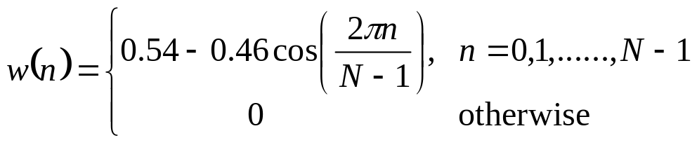
Why Windowing? (3)
Windowing (Cont.):
  For a designed window, we wish that
    the main lobe is as narrow as possible in its width
    the side lobe is as lower as possible in its magnitude
      However, this is a trade-off!
  The most-used window shape is the Hamming window, whose impulse response is a raised cosine impulse:

Slide 32
Feature Extraction : DFT and Mel-filter bank processing
For each frame of signal (N points, e.g., N=512),
  the Discrete Fourier Transform (DFT) is first performed to obtain its spectrum (M points, for example M=512)
  The bank of filters according to Mel scale is then performed, and the each filter output is the sum of its filtered spectral components (K filters, and thus K points, for example K=24)
sum
Y_{t}(1)
f
Time domain signal
spectrum
sum
Y_{t}(2)
t
DFT
f
f
x_{t}(n)
X_{t}(k)
sum
Y_{t}(K)
f

Slide 33
Why Filter-bank Processing?
The filter-bank processing simulates human ear processing
  Center frequency of each filter :
    The position of maximum displacement along the basilar membrane for stimuli such as pure tone is proportional to the logarithm of the frequency of the tone
  Bandwidth :
    Frequencies of a complex sound within a certain bandwidth of some nominal frequency cannot be individually identified.
    When one of the components of this sound falls outside this bandwidth, it can be individually distinguished.
    This bandwidth is referred to as the critical bandwidth.
    A critical Bandwidth is nominally 10% to 20% of the center frequency of the sound

Slide 34
Why Filter-bank Processing?
For Speech Recognition Purpose :
  Filters are non-uniformly spaced along the frequency axis.
  The part of the spectrum below 1kHz is processed by more filter banks
    This part contains more information on the vocal tract such as the first formant
  Non-linear frequency analysis is also used to achieve frequency/time resolution
    Narrow band-pass filters at low frequencies enables harmonics to be detected
    Longer bandwidth at higher frequencies allows for higher temporal resolution of bursts

Slide 35
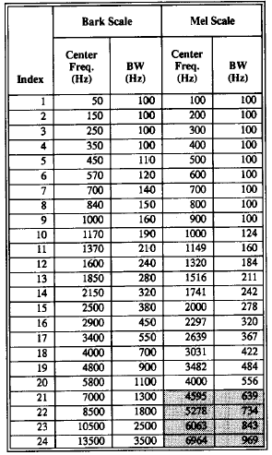
Why Filter-bank Processing?
The most-used two warped frequency scale : Bark scale and Mel scale

Slide 36
Feature Extraction : Logarithmic operation and IDFT
The final process of MFCC construction : logarithm operation and IDFT
Mel-filter output
spectral vector Y_{t}
Filter index
Log(| |²)
Log-spectral vector Y’_{t}
Filter index
IDFT
y_{t}=CY’_{t}
MFCC vector y_{t}
quefrency

Slide 37
Why Log Energy Computation?
Using the magnitude (energy) only since …..
  Phase information is useless in speech recognition
    Replacing the phase part of the original speech signal with continuous random phase won’t be perceived by human ear
Using the Logarithmic operation since ……
  The logarithm of the spectrum has the effect of reducing the component amplitudes at every frequency, which is a characteristic of the human hearing system
  It performs a dynamic compression, making feature extraction less sensitive to variations in dynamics
  In order to separate more easily the excitation produced by the vocal cords and the the filter that represents the vocal tract
    Speech signal x(n), excitation v(n) and the impulse response of vocal tract h(n)
    x(n)=v(n)*h(n) ➔X(ω)=V(ω)H(ω)
    ➔ |X(ω)|=|V(ω)||H(ω)| ➔log|X(ω)|=log|V(ω)|+log|H(ω)|

Slide 38
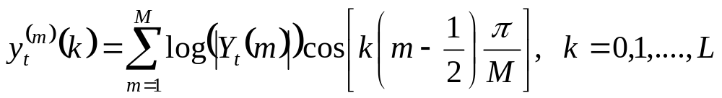
Why Inverse DFT?
Final procedure for MFCC : performing the inverse DFT on the log-spectral power
Great advantages :
  Since the log-power spectrum is real and symmetric, the inverse DFT reduces to a Discrete Cosine Transform (DCT). The DCT has the property to produce more highly uncorrelated features y_{t} than log(|Y_{t}|)
  Cepstral coefficients are more compact since they are sorted in variance order
    can be truncated to retain the highest energy coefficients, which represents an implicit liftering operation with a rectangular window
  Successfully separates the vocal tract and the excitation
    The envelope of the vocal tract changes slowly, and thus at low quefrencies (lower order cepstrum), while the periodic excitation are at high quefrencies (higher order cepstrum)

Slide 39
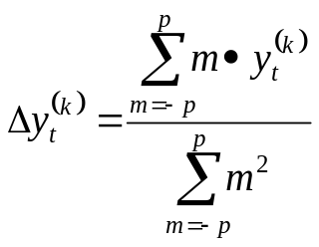
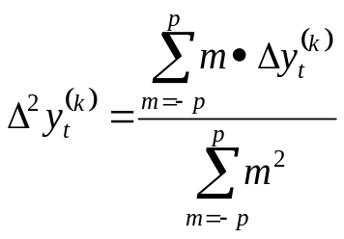
Feature Extraction : Derivatives
Derivative operation : to obtain the temporal information of the static feature vector
n-1 n n+1 n+2
quefrency
MFCC stream y_{t}
Frame index
quefrency
ΔMFCC stream Δy_{t}
Frame index
quefrency
Δ² MFCC stream Δ²y_{t}
Frame index

Slide 40
Why Delta coefficients?
To capture the dynamic evolution of the speech signal
  Such information carries relevant information for speech recognition
  The distance (the value of p) should be taken into account since …..
    Too low distance may imply too correlated frames and therefore the dynamic cannot be caught
    Too high values may imply frames describing too different states
To cancel the DC part (channel effect) of the MFCC features
  For example, for clean speech, the MFCC stream is
  {y(t-N), y(t-N+1),…....,y(t), y(t+1), y(t+2), ……},
  while for a channel-distorted speech, the MFCC stream is
  {y(t-N)+h, y(t-N+1)+h,…....,y(t)+h, y(t+1)+h, y(t+2)+h, ……}
  the channel effect h is eliminated in the delta (difference) coefficients

Slide 41
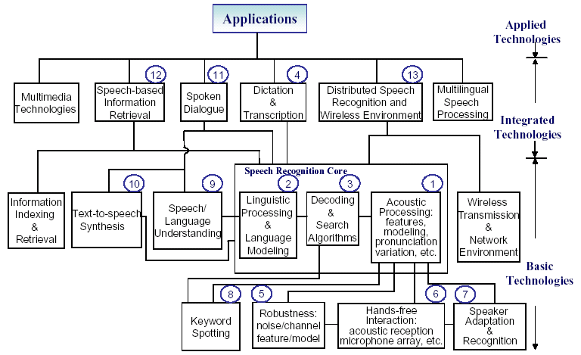
語音領域可研究方向

Slide 42
MSP論壇、paper選讀、書籍網站推薦
MSP論壇-- http://phpbb.msp.dhs.org/
書籍網站推薦
  X. Huang, A. Acero, H. Hon, “Spoken Language Processing”, Prentice Hall, 2001,松瑞
  F. Jelinek, “Statistical Methods for Speech Recognition”, MIT Press, 1999
  L. Rabiner, B.H. Juang, “Fundamentals of Speech Recognition”, Prentice Hall, 1993,民全
  C. Becchetti, L. Prina Ricotti, “Speech Recognition- Theory and C++ implementation”,Johy Wiley and Sons, 1999, 民全
網站介紹
  IEEE http://ieeexplore.ieee.org
  Speech communication http://sdos.ejournal.ascc.net/cgi-bin/sciserv.pl?collection=journals&journal=01676393
  Multilingual http://www.lti.cs.cmu.edu/~tanja/

Slide 43
作業二
Paper選讀
  AGGLOMERATIVE VS. TREE-BASED CLUSTERING FOR THE DEFINITION OF MULTILINGUAL SET OF TRIPHONES ICASSP2000,1647_159.PDF
  Conversational Interfaces: Advances and Challenges, PROCEEDINGS OF THE IEEE, VOL. 88, NO. 8, AUGUST 2000
  The past, present, and future of speech processing, IEEE signal processing magazine, May 1998.
  三人合作看一篇

